Slide 1

TensorFlow
Day 4: RNN
Sung Kim <hunkim+tfust@gmail.com>

Slide 2
주의사항
본 자료는 배포된 실제 실습예제(TensorFlow_Tutorial_RNN.ipynb)와는 다소 차이가 있습니다.
따라서 단순히 코드의 원리를 이해하는 데만 본 자료를 참고하시고, 배포된 코드를 중심으로 실습 하시길 바랍니다.

Slide 3
Sequence data
Hard to understand the context from single word
We understand based on the previous words + this word. (time series)
NN/CNN cannot do this

Slide 4
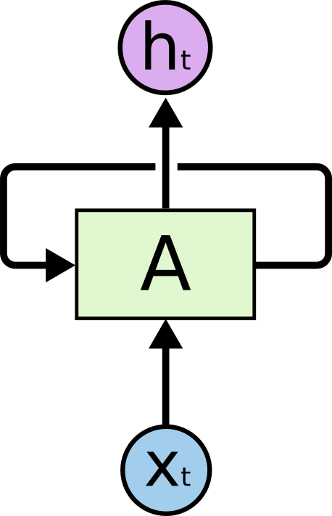
Sequence data
Hard to understand the context from single word
We understand based on the previous words + this word. (time series)
NN/CNN cannot do this
http://colah.github.io/posts/2015-08-Understanding-LSTMs/

Slide 5

http://colah.github.io/posts/2015-08-Understanding-LSTMs/

Slide 6
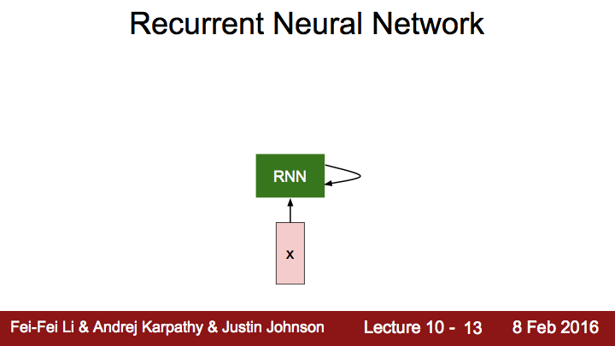

Slide 7
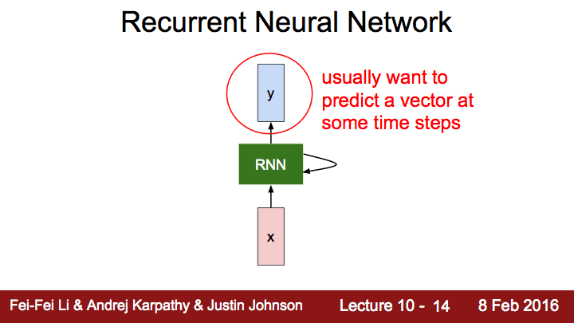

Slide 8
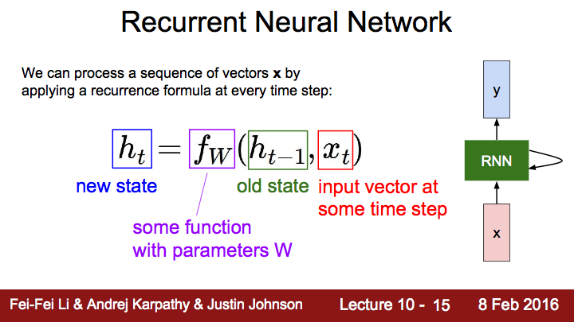

Slide 9
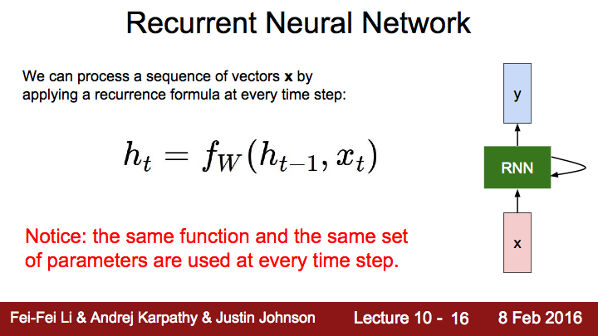

Slide 10
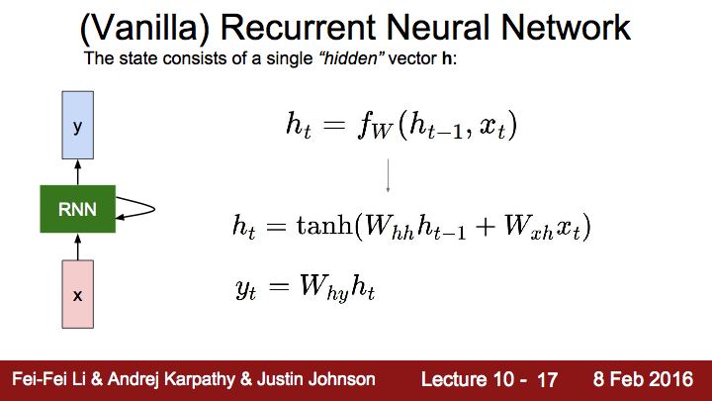

Slide 11

http://colah.github.io/posts/2015-08-Understanding-LSTMs/

Slide 12
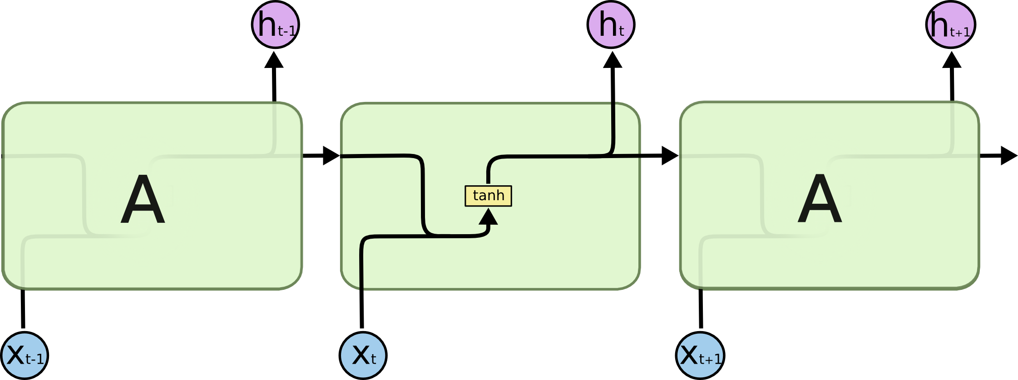
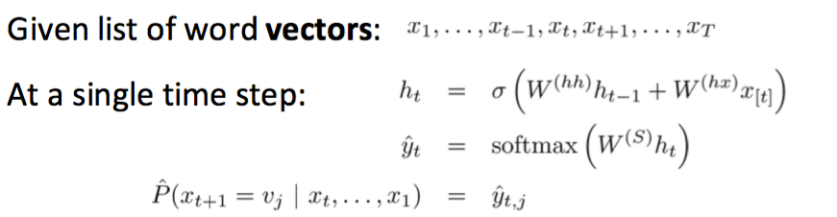
Notes:
Main idea: we use the same set of W weights at all time steps!

Slide 13
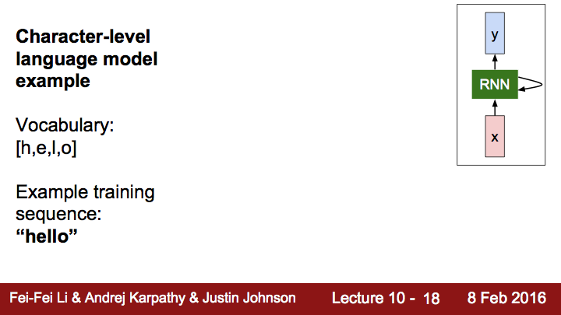
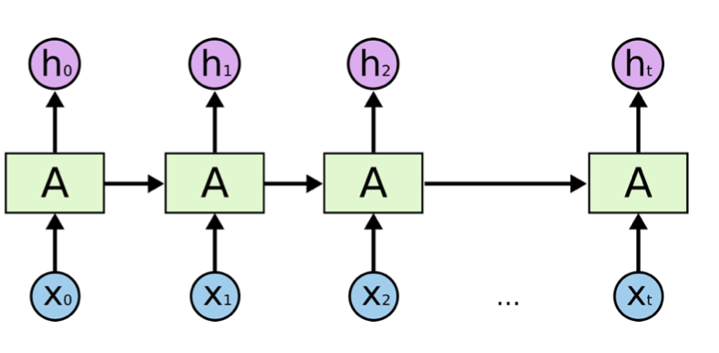

Slide 14
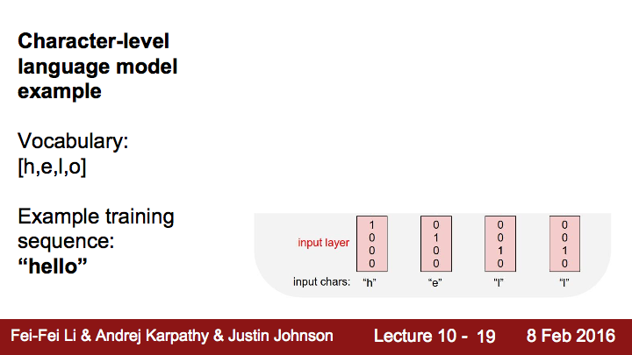

Slide 15
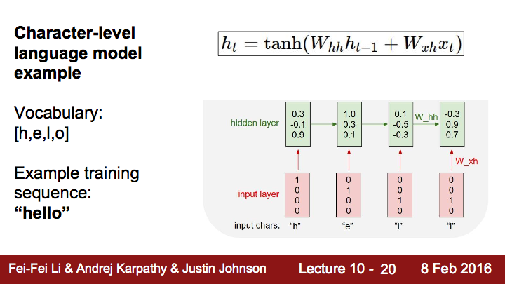



Slide 16


Slide 19
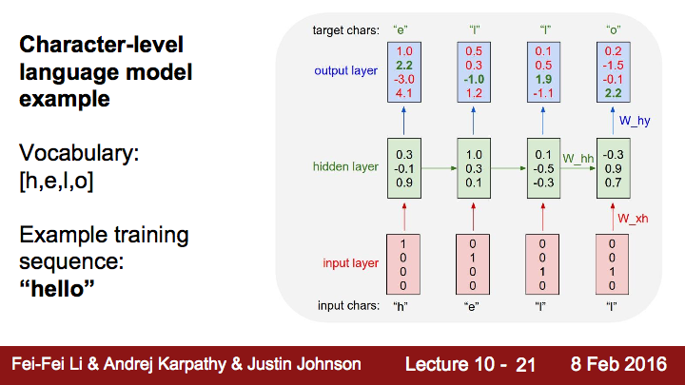




Slide 21
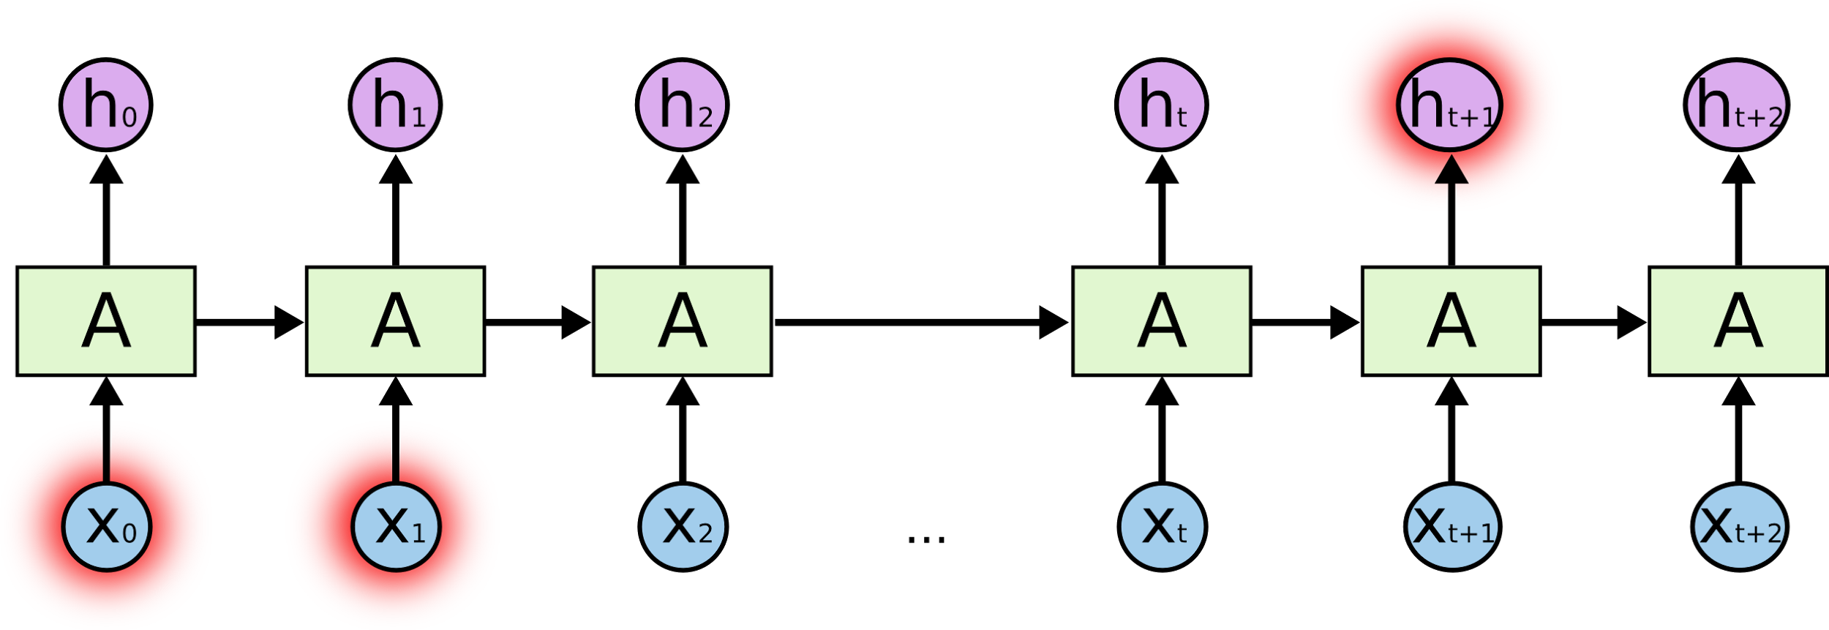
실습 Simple toy seq2seq with RNN / LSTM

Slide 22
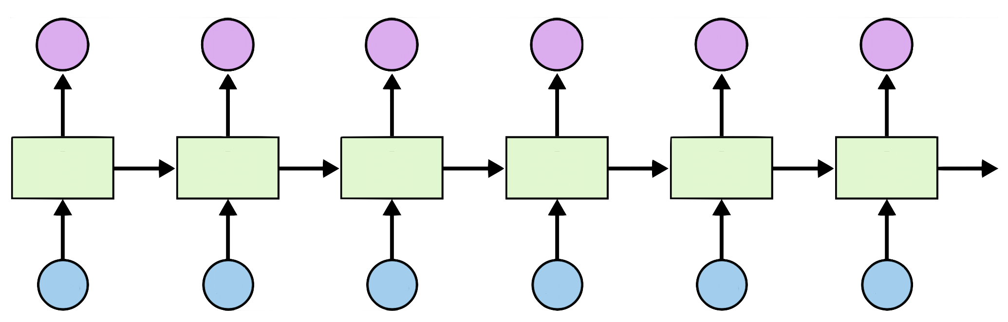
Teach RNN ‘hihello’
i
h
e
l
l
o
h
i
h
e
l
l

Slide 23
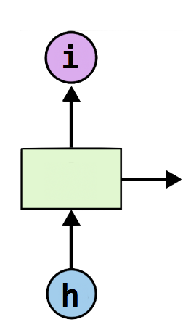
One-hot encoding
text: ‘hihello’
unique chars (vocabulary, voc):
h, i, e, l, o
voc index:
h:0, i:1, e:2, l:3, o:4
[1, 0, 0, 0, 0], # h 0
[0, 1, 0, 0, 0], # i 1
[0, 0, 1, 0, 0], # e 2
[0, 0, 0, 1, 0], # l 3
[0, 0, 0, 0, 1], # o 4

Slide 24
Teach RNN ‘hihello’
[1, 0, 0, 0, 0], # h 0
[0, 1, 0, 0, 0], # i 1
[0, 0, 1, 0, 0], # e 2
[0, 0, 0, 1, 0], # l 3
[0, 0, 0, 0, 1], # o 4
[0, 1, 0, 0, 0]
[1, 0, 0, 0, 0]
[0, 1, 0, 0, 0]
[0, 1, 0, 0, 0]
[0, 1, 0, 0, 0]
[0, 0, 0, 0, 1]
i
h
e
l
l
o
h
i
h
e
l
l
[1, 0, 0, 0, 0]
[0, 1, 0, 0, 0]
[1, 0, 0, 0, 0]
[0, 1, 0, 0, 0]
[0, 1, 0, 0, 0]
[0, 1, 0, 0, 0]

Slide 25
Creating rnn cell
# RNN model
rnn_cell = rnn_cell.BasicRNNCell(rnn_size)
rnn_cell = rnn_cell. BasicLSTMCell(rnn_size)
rnn_cell = rnn_cell. GRUCell(rnn_size)

Slide 26
Creating rnn cell
# RNN model
rnn_cell = rnn_cell.BasicRNNCell(rnn_size)
rnn_cell = rnn_cell. BasicLSTMCell(rnn_size)
rnn_cell = rnn_cell. GRUCell(rnn_size)

Slide 27


Execute RNN
hidden_rnn_size
# RNN model
rnn_cell = rnn_cell.BasicRNNCell(rnn_size)
outputs, _states = tf.nn.dynamic_rnn(
rnn_cell,
X,
initial_state=initial_state,
dtype=tf.float32)

Slide 28
RNN parameters
text: ‘hihello’
unique chars (vocabulary, voc):
h, i, e, l, o
voc index:
h:0, i:1, e:2, l:3, o:4
hidden_size = 5 # output from the LSTM
input_dim = 5 # one-hot size
batch_size = 1 # one sentence
sequence_length = 6 # |ihello| == 6
https://github.com/hunkim/DeepLearningZeroToAll/blob/master/lab-12-1-hello-rnn.py

Slide 29
Data creation
idx2char = ['h', 'i', 'e', 'l', 'o'] # h=0, i=1, e=2, l=3, o=4
x_data = [[0, 1, 0, 2, 3, 3]] # hihell
x_one_hot = [[[1, 0, 0, 0, 0], # h 0
[0, 1, 0, 0, 0], # i 1
[1, 0, 0, 0, 0], # h 0
[0, 0, 1, 0, 0], # e 2
[0, 0, 0, 1, 0], # l 3
[0, 0, 0, 1, 0]]] # l 3
y_data = [[1, 0, 2, 3, 3, 4]] # ihello
X = tf.placeholder(tf.float32,
[None, sequence_length, input_dim]) # X one-hot
Y = tf.placeholder(tf.int32, [None, sequence_length]) # Y label
https://github.com/hunkim/DeepLearningZeroToAll/blob/master/lab-12-1-hello-rnn.py

Slide 30
Feed to RNN
x_one_hot = [[[1, 0, 0, 0, 0], # h 0
[0, 1, 0, 0, 0], # i 1
[1, 0, 0, 0, 0], # h 0
[0, 0, 1, 0, 0], # e 2
[0, 0, 0, 1, 0], # l 3
[0, 0, 0, 1, 0]]] # l 3
y_data = [[1, 0, 2, 3, 3, 4]] # ihello
X = tf.placeholder(
tf.float32, [None, sequence_length, hidden_size]) # X one-hot
Y = tf.placeholder(tf.int32, [None, sequence_length]) # Y label
cell = tf.contrib.rnn.BasicLSTMCell(num_units=hidden_size, state_is_tuple=True)
initial_state = cell.zero_state(batch_size, tf.float32)
outputs, _states = tf.nn.dynamic_rnn(
cell, X, initial_state=initial_state, dtype=tf.float32)
https://github.com/hunkim/DeepLearningZeroToAll/blob/master/lab-12-1-hello-rnn.py

Slide 31
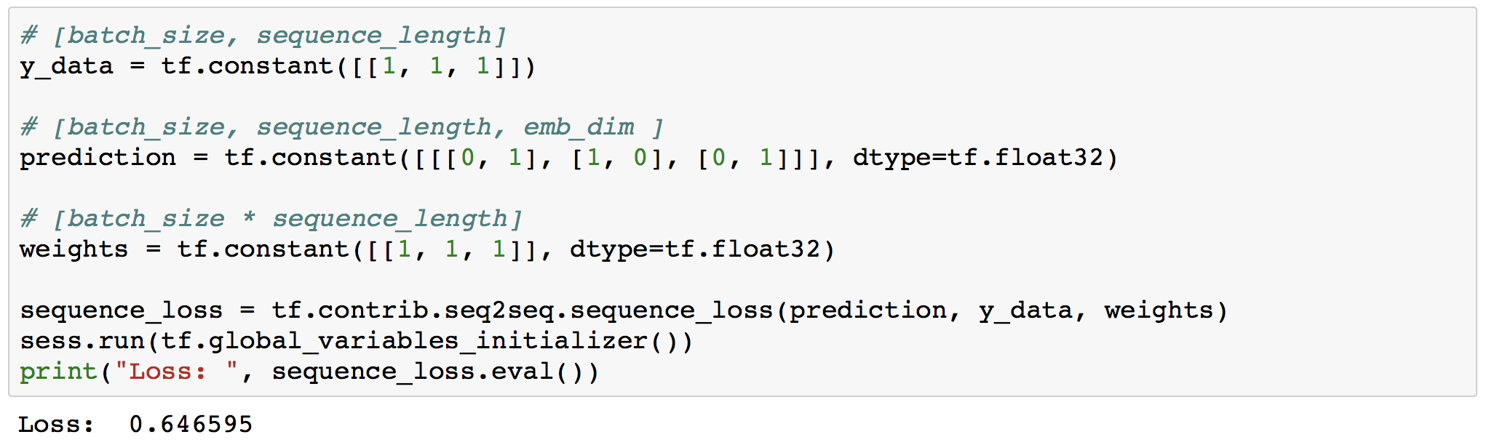
Cost: sequence_loss
https://github.com/hunkim/DeepLearningZeroToAll/blob/master/lab-12-0-rnn_basics.ipynb

Slide 32
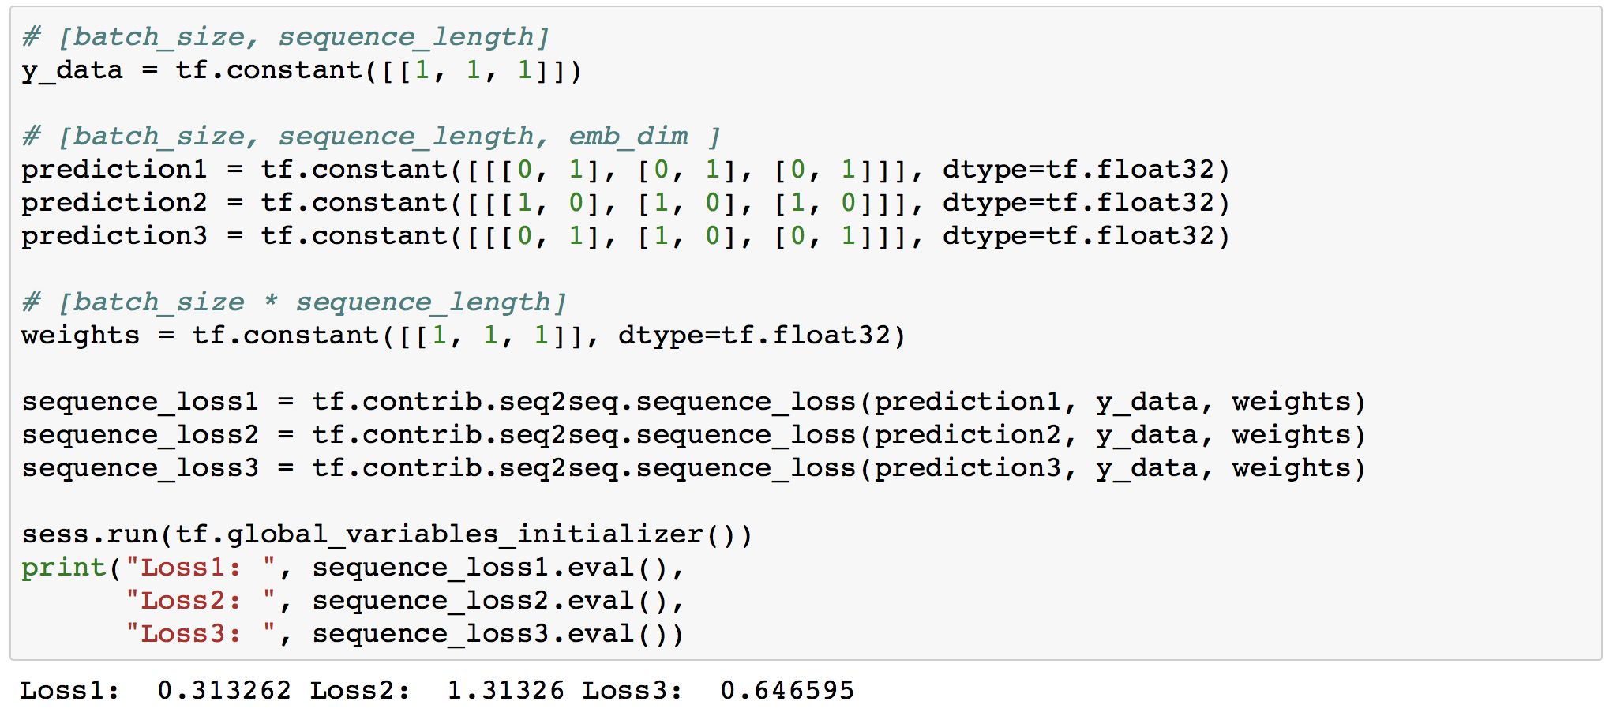
Cost: sequence_loss
https://github.com/hunkim/DeepLearningZeroToAll/blob/master/lab-12-0-rnn_basics.ipynb

Slide 33
Cost: sequence_loss
outputs, _states = tf.nn.dynamic_rnn(
cell, X, initial_state=initial_state, dtype=tf.float32)
weights = tf.ones([batch_size, sequence_length])
sequence_loss = tf.contrib.seq2seq.sequence_loss(
logits=outputs, targets=Y, weights=weights)
loss = tf.reduce_mean(sequence_loss)
train = tf.train.AdamOptimizer(learning_rate=0.1).minimize(loss)
https://github.com/hunkim/DeepLearningZeroToAll/blob/master/lab-12-1-hello-rnn.py

Slide 34
Training
prediction = tf.argmax(outputs, axis=2)
with tf.Session() as sess:
sess.run(tf.global_variables_initializer())
for i in range(2000):
l, _ = sess.run([loss, train], feed_dict={X: x_one_hot, Y: y_data})
result = sess.run(prediction, feed_dict={X: x_one_hot})
print(i, "loss:", l, "prediction: ", result, "true Y: ", y_data)
# print char using dic
result_str = [idx2char[c] for c in np.squeeze(result)]
print("\tPrediction str: ", ''.join(result_str))
https://github.com/hunkim/DeepLearningZeroToAll/blob/master/lab-12-1-hello-rnn.py

Slide 35
Results
prediction = tf.argmax(outputs, axis=2)
with tf.Session() as sess:
sess.run(tf.global_variables_initializer())
for i in range(2000):
l, _ = sess.run([loss, train], feed_dict={X: x_one_hot, Y: y_data})
result = sess.run(prediction, feed_dict={X: x_one_hot})
print(i, "loss:", l, "prediction: ", result, "true Y: ", y_data)
# print char using dic
result_str = [idx2char[c] for c in np.squeeze(result)]
print("\tPrediction str: ", ''.join(result_str))
0 loss: 1.55474 prediction: [[3 3 3 3 4 4]] true Y: [[1, 0, 2, 3, 3, 4]] Prediction str: lllloo
1 loss: 1.55081 prediction: [[3 3 3 3 4 4]] true Y: [[1, 0, 2, 3, 3, 4]] Prediction str: lllloo
2 loss: 1.54704 prediction: [[3 3 3 3 4 4]] true Y: [[1, 0, 2, 3, 3, 4]] Prediction str: lllloo
3 loss: 1.54342 prediction: [[3 3 3 3 4 4]] true Y: [[1, 0, 2, 3, 3, 4]] Prediction str: lllloo
...
1998 loss: 0.75305 prediction: [[1 0 2 3 3 4]] true Y: [[1, 0, 2, 3, 3, 4]] Prediction str: ihello
1999 loss: 0.752973 prediction: [[1 0 2 3 3 4]] true Y: [[1, 0, 2, 3, 3, 4]] Prediction str: ihello
https://github.com/hunkim/DeepLearningZeroToAll/blob/master/lab-12-1-hello-rnn.py

Slide 36
Manual data creation
idx2char = ['h', 'i', 'e', 'l', 'o']
x_data = [[0, 1, 0, 2, 3, 3]] # hihell
x_one_hot = [[[1, 0, 0, 0, 0], # h 0
[0, 1, 0, 0, 0], # i 1
[1, 0, 0, 0, 0], # h 0
[0, 0, 1, 0, 0], # e 2
[0, 0, 0, 1, 0], # l 3
[0, 0, 0, 1, 0]]] # l 3
y_data = [[1, 0, 2, 3, 3, 4]] # ihello
https://github.com/hunkim/DeepLearningZeroToAll/blob/master/lab-12-1-hello-rnn.py

Slide 37
사실은..
RNN에서 Softmax를 쓰려면, 사실은 다음과 같은 과정을 거쳐야 한다.
이는 tf.reshape 함수를 이용해서 RNN에서의 shared softmax layer를 구현하기 위함이다.

Slide 38
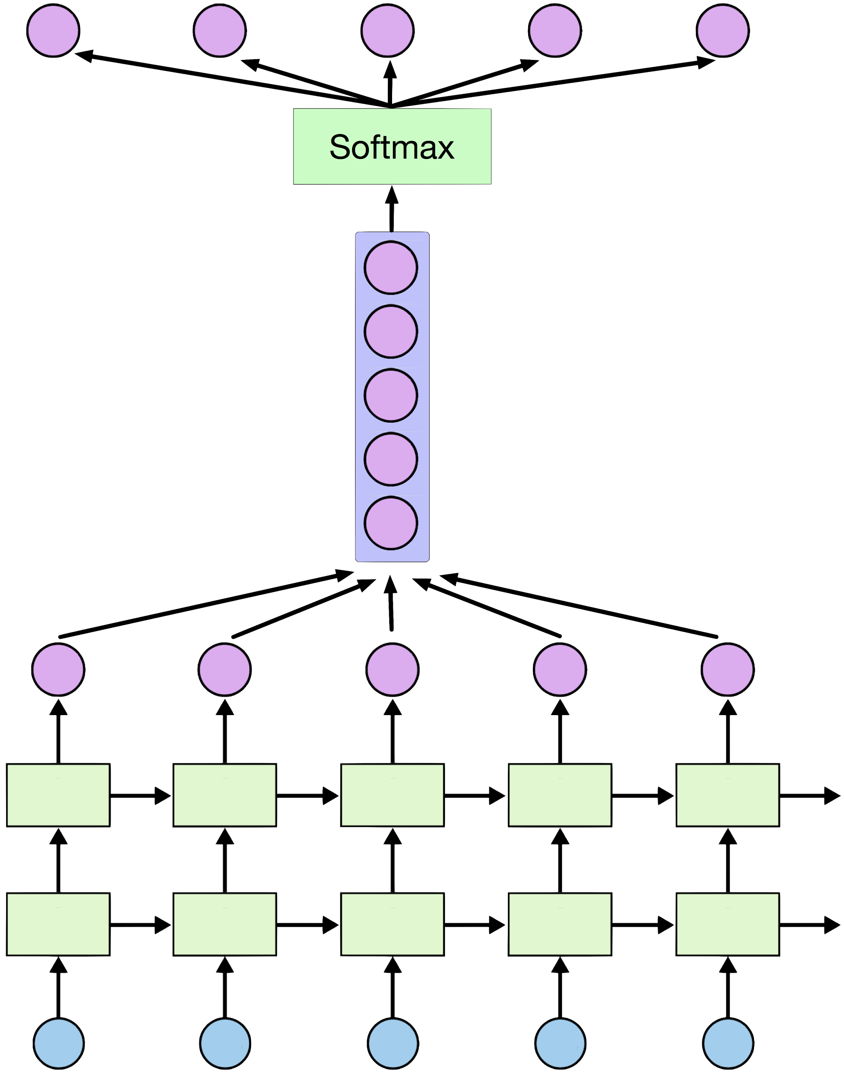
Softmax in RNN
outputs, _ = tf.nn.dynamic_rnn(cell, X_one_hot)
https://github.com/hunkim/DeepLearningZeroToAll/blob/master/lab-12-4-rnn_long_char.py

Slide 39
Softmax
outputs = tf.reshape(outputs,
[batch_size, seq_length, num_classes])
X_for_softmax = tf.reshape(outputs,
[-1, hidden_size])
outputs, _ = tf.nn.dynamic_rnn(cell, X_one_hot)
https://github.com/hunkim/DeepLearningZeroToAll/blob/master/lab-12-4-rnn_long_char.py

Slide 40
Softmax
# (optional) softmax layer
X_for_softmax = tf.reshape(outputs, [-1, hidden_size])
softmax_w = tf.get_variable("softmax_w",
[hidden_size, num_classes]
softmax_b = tf.get_variable("softmax_b",[num_classes])
outputs = tf.matmul(X_for_softmax,softmax_w) + softmax_b
outputs = tf.reshape(outputs,
[batch_size, seq_length, num_classes])
https://github.com/hunkim/DeepLearningZeroToAll/blob/master/lab-12-4-rnn_long_char.py

Slide 41
Loss
# reshape out for sequence_loss
outputs = tf.reshape(outputs,
[batch_size, seq_length, num_classes])
# All weights are 1 (equal weights)
weights = tf.ones([batch_size, seq_length])
sequence_loss = tf.contrib.seq2seq.sequence_loss(
logits=outputs, targets=Y, weights=weights)
mean_loss = tf.reduce_mean(sequence_loss)
train_op =
tf.train.AdamOptimizer(learning_rate=0.1).minimize(mean_loss)
https://github.com/hunkim/DeepLearningZeroToAll/blob/master/lab-12-4-rnn_long_char.py

